Slide 1
Frontend Sessions
HTML5, CSS3, Javascript and Jquery
by: Seshu Puvvada

Slide 2
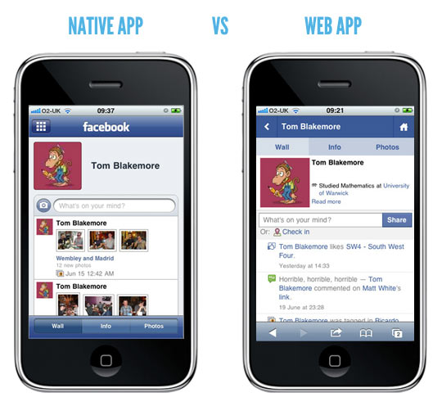
What ?
what is web / static / dynamic application ?
what is mobile web / native / hybrid application ?
By: Seshu Puvvada

Slide 3
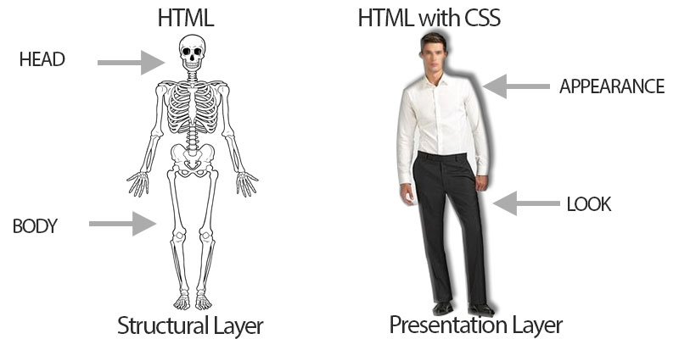
What?
What is HTML ?
What is CSS ?
What is Javascript ?
What is HTTP?
By: Seshu Puvvada

Slide 4

Technologies and Frameworks
By: Seshu Puvvada

Slide 5
IDE ?
Eclipse
Notepad++
Visual studio
Webstrom
Atom etc…
By: Seshu Puvvada

Slide 6
HTML Document Structure
Parent and child structure
doctype – declaration of standards compliance
html – Root element
head – Document metadata
Used by browsers and search engines
body – Document data
Displayed to the users by the client browser
<!DOCTYPE html>
<html>
<head>
<title>Welcome</title>
</head>
<body>
<h1>Welcome to HTML</h1>
</body>
</html>
By: Seshu Puvvada

Slide 7
<head> metadata
<title>
Title of the document
<meta>
Includes metadata of the application such as keywords, description etc..
<script>
Includes script
<style>
Define styles for body elements
<link>
Directive indicating related documents
<base>
Define base address for all relative links on the page
By: Seshu Puvvada

Slide 8
Basic HTML Elements
Headings h1 to h6
Paragraph (p, pre)
Links(a)
Images(img)
Attributes – provides additional information about an element
Title
Href
Src
Width, height
Alt etc…
By: Seshu Puvvada
Notes:
<pre> – to preserve spaces and breaks.

Slide 9
Text elements
<b> - bold
<strong> - strong
<i> - italic
<em> - emphasized
<small> - small
<mark> - marked
<del> - deleted
<sub> - subscript
<sup> - superscript
By: Seshu Puvvada

Slide 10
HTML Style
What is Style
Inline styling
<p style="color:red">This is a paragraph.</p>
Internal styling - Using Style tag
<style> p { color: red; } </style>
External Style sheet
mystyle.css
Basic styling properties
background-color, color, font-size, font-family, text-align, border, padding, margin etc…
By: Seshu Puvvada

Slide 11
CSS Selectors
Id selector
#tagid{ css properties }
Element selector
h1{ css properties }
Class selector
.myheader{ css properties }
By: Seshu Puvvada

Slide 12
Block Vs Inline
Block elements
Container elements for grouping
May contain other block or inline elements
New lines appear
Can have width and height, it takes whole page width
Div, h1, p, form etc…
Inline elements
Container for text and other inline elements
No new line before or after
Has no width and height
span, a, img etc..
By: Seshu Puvvada

Slide 13
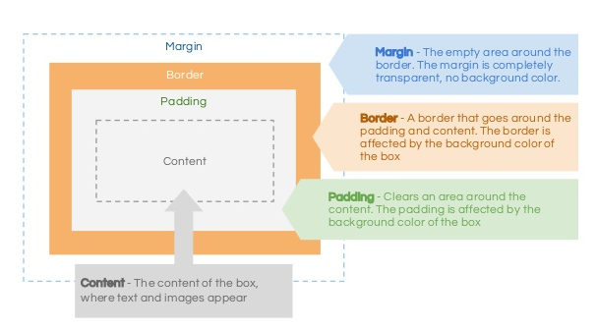
CSS Box Model
By: Seshu Puvvada

Slide 14
HTML Links
Anchor Element
<a href="http://www.syntelinc.com">Welcome to syntel</a>
What is target -- _self and _blank
<a href="http://www.syntelinc.com" target="_blank">Welcome to syntel</a>
Image with link
<a href="http://www.syntelinc.com" target="_blank“> <img src="welcome.jpg" /> </a>
Bookmarking Section
<a href="#Zaheer">Zaheer Khan Open to Bowling Coach Role in Indian Team </a>
By: Seshu Puvvada

Slide 15
HTML List
Unordered list
<ul> <li>item name</li> </ul>
list-style-type:square, circle, disc
Ordered list
<ol> <li>item name</li> </ol>
type = “1”, A, a, I, i
List item
By: Seshu Puvvada

Slide 16
HTML Input elements
Text
<input type="text" name="username">
Password
<input type="password" name="psw">
Submit
<input type="submit" value="Submit">
Radio
<input type="radio" name=“accept" value=“yes" checked>
Checkbox
<input type="checkbox" name=“country" value=“India">
By: Seshu Puvvada

Slide 17
CSS Selectors
#id -- #divid
Tagname – div
Cssclassname -- .class
Multiple css class – class=“class1 class2”
div.class1 -- element with classname ‘class1’
div .class1 – element child/grand child/ grand grand child… with classname ‘class1’
div>class1 – element immediate child with classname ‘class1’

Slide 18
Position
Static
Relative
Fixed
Absolute

Slide 19
Pseduo Class

